Slide 1

AI-Driven Medical Chatbot:Transforming Physician-Patient Communication through Natural Language Understanding
REU Presentation on
Sl.No | Name | USN | Roll Number
1 | Srithan M.S | 01FE21BCS016 | 503
Guided By: Dr. Suvarna Kanakaraddi

Slide 2

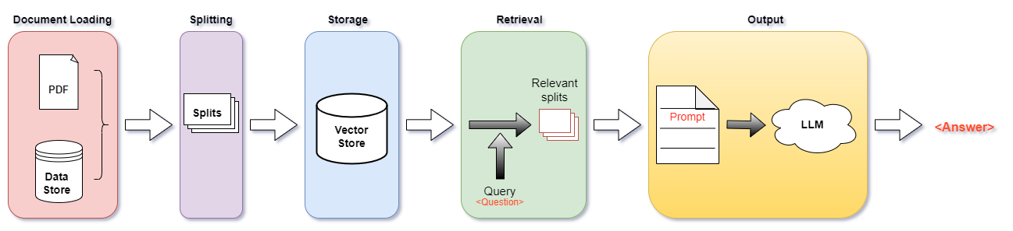
Proposed System
Figure 1:System flow diagram

Slide 3
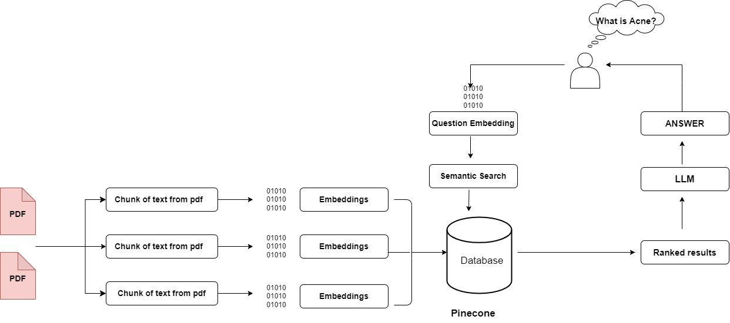
Embedding Generation with LangChain
Figure 2: Embedding Pipeline for Semantic Search and Retrieval Using LLM.

Slide 4
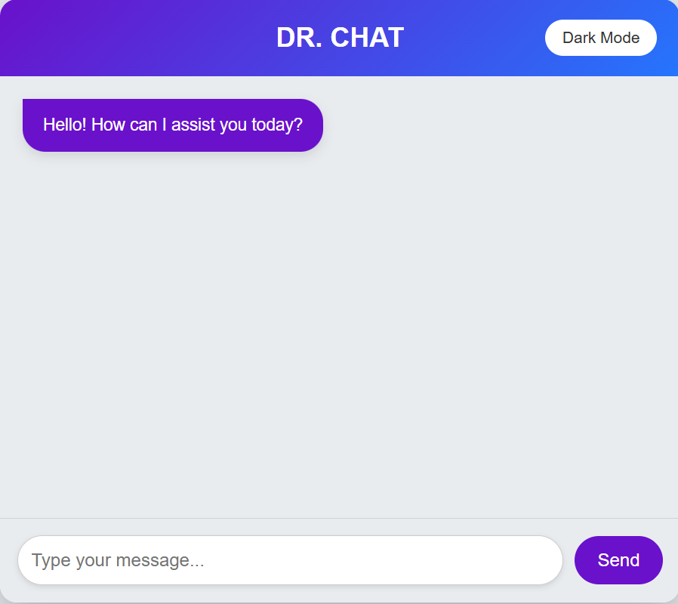
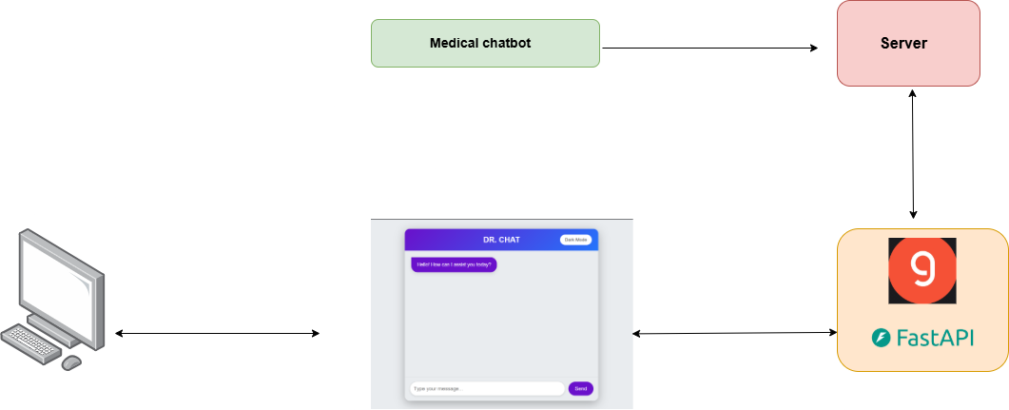
Web App (contd.)
Frontend-Backend Communication:
API Requests: The frontend sends user queries to the backend via GROQ API.
Processing & Retrieval: The backend processes the request, retrieves relevant information, and generates a response.
Response Delivery: The backend sends the processed response back to the frontend for display.
Figure 3: Front end
Figure 4: Back end

Slide 5
Thank You

